Slide 1


MY FAMILY

Slide 2


Slide 3
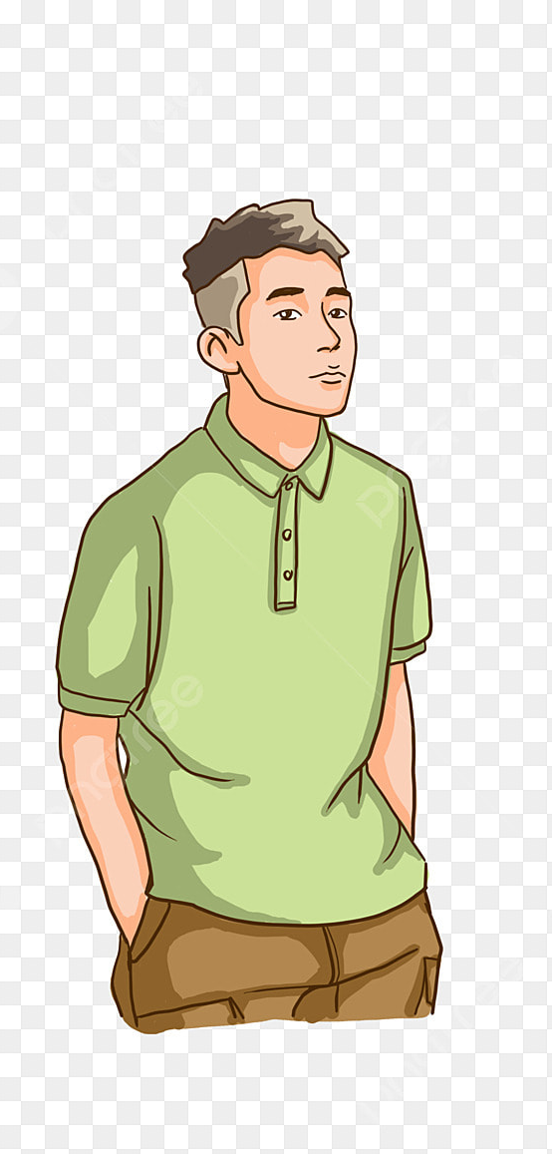
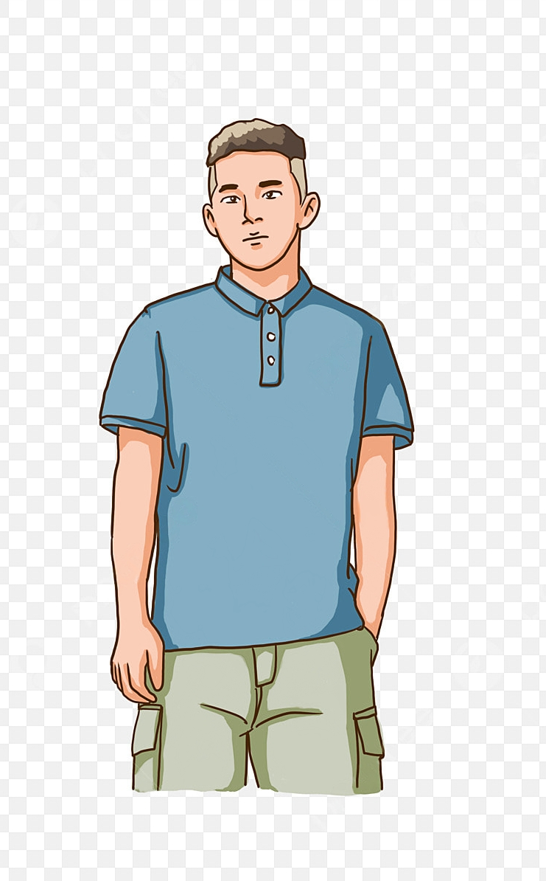



Slide 4



Slide 5
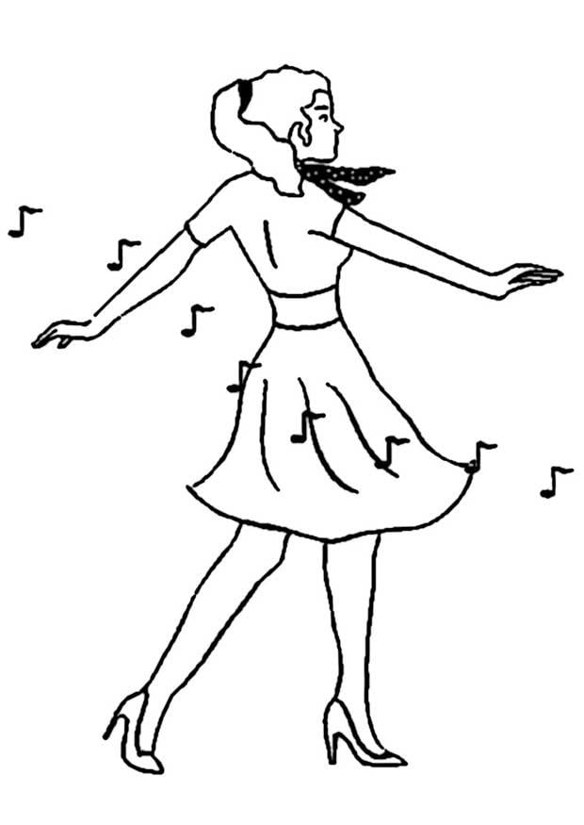


Slide 6
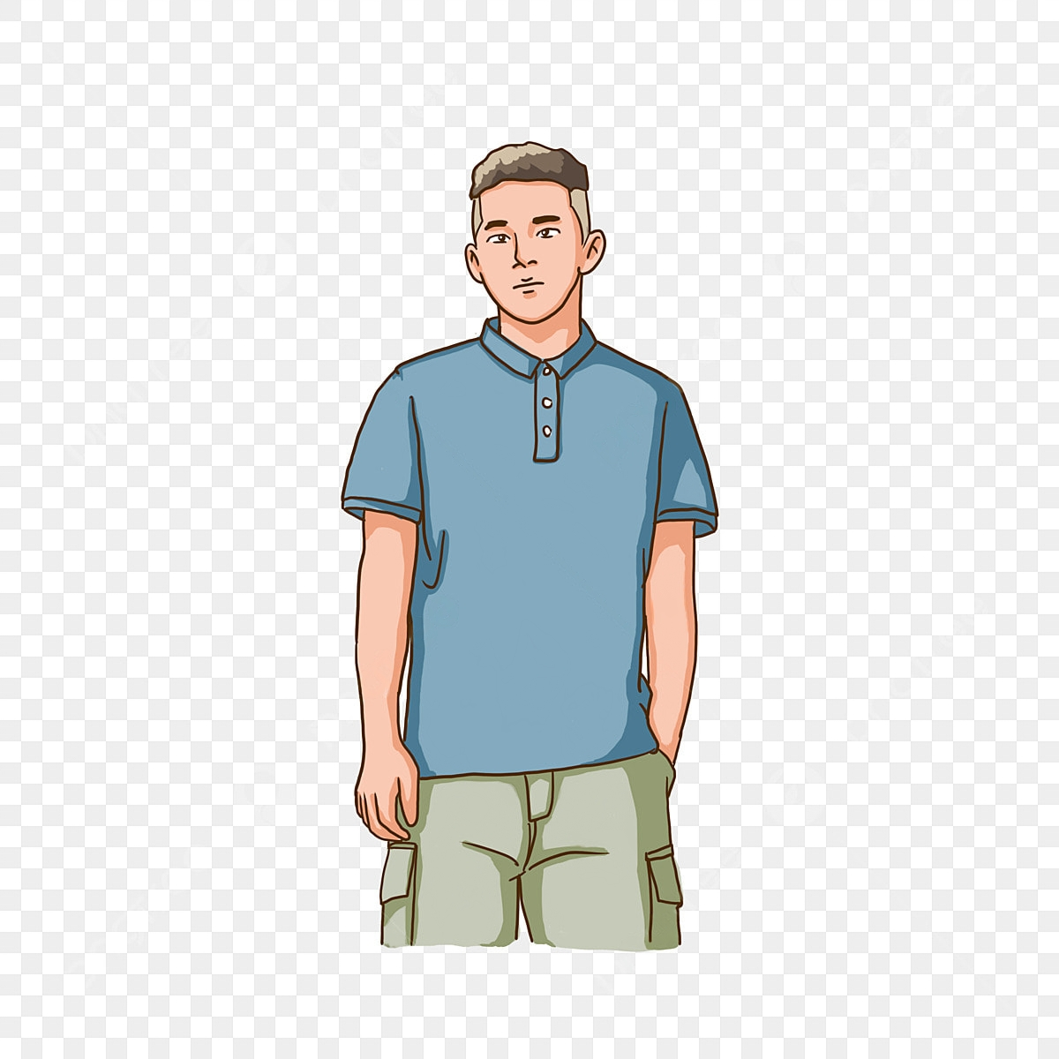


Slide 7


Slide 8


Slide 9


Slide 10


